Slide 1
Introduction to the Application Layer
Copyright © The McGraw-Hill Companies, Inc. Permission required for reproduction or display.

Slide 2
17-1 CLIENT-SERVER PARADIGM
The purpose of a network, or an internetwork, is to provide services to users: A user at a local site wants to receive a service from a computer at a remote site.
One way to achieve this purpose is to run two programs.
A local computer runs a program to request a service from a remote computer; the remote computer runs a program to give service to the requesting program.
This means that two computers, connected by an internet, must each run a program, one to provide a service and one to request a service.

Slide 3
Questions arise when we want to implement the approach.
Should both application programs be able to request services and provide services or should the application programs just do one or the other?
2. Should a server provide services only to one specific client or should the server be able to provide services to any client that requests the type of service it provides?
3. Should a computer run only one program (client or server)?
4. When should an application program be running? All of the time or just when there is a need for the service?
5. Should there be only one universal application program that can provide any type of service a user wants?
Or should there be one application program for each type of service?

Slide 4
Server
program running on the remote machine providing service to the clients.
A server program is an infinite program.
It waits for incoming requests from clients. When a request arrives, it responds to the request, either iteratively or concurrently.
Client
A client is a program running on the local machine requesting service from a server.
A client program is finite, which means it is started by the user and terminates when the service is complete.
Client opens the communication channel using the IP address and well-known port address of specific server program.

Slide 5
Concurrency
Both clients and servers can run in concurrent mode.
Concurrency in Clients
Clients can be run on a machine either iteratively or concurrently.
iteratively means running them one by one; one client must start, run, and terminate before the machine can start another client.
Most computers today, allow concurrent clients; that is, two or more clients can run at the same time.
Concurrency in Servers
An iterative server can process only one request at a time; it receives a request, processes it, and sends the response to the requestor before it handles another request.
A concurrent server, on the other hand, can process many requests at the same time and thus can share its time between many requests.
The servers use either UDP or TCP

Slide 6
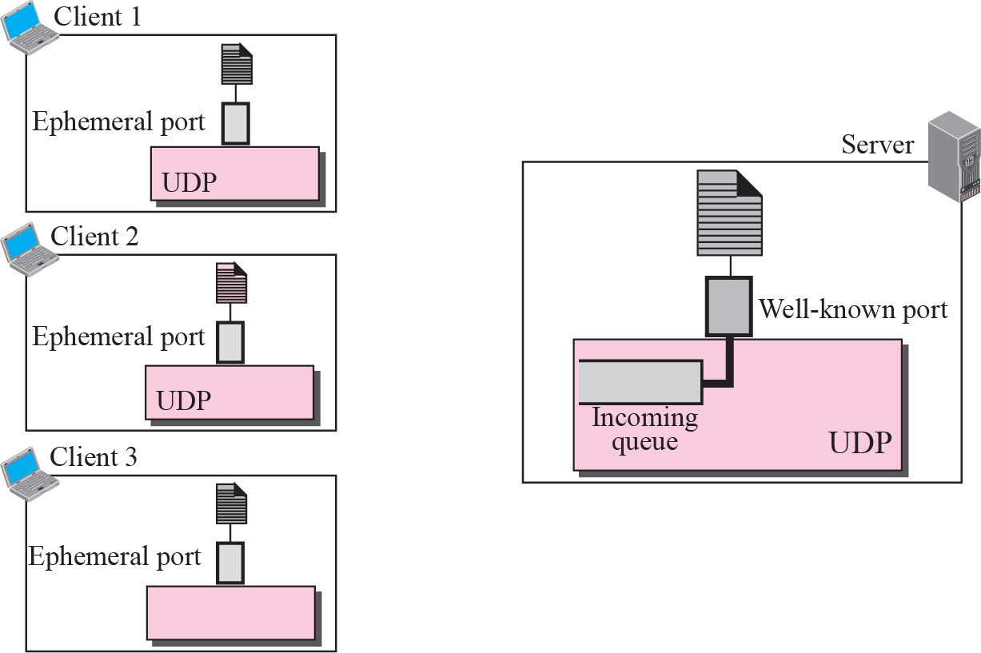
Figure 17.2 Connectionless iterative server

Slide 7
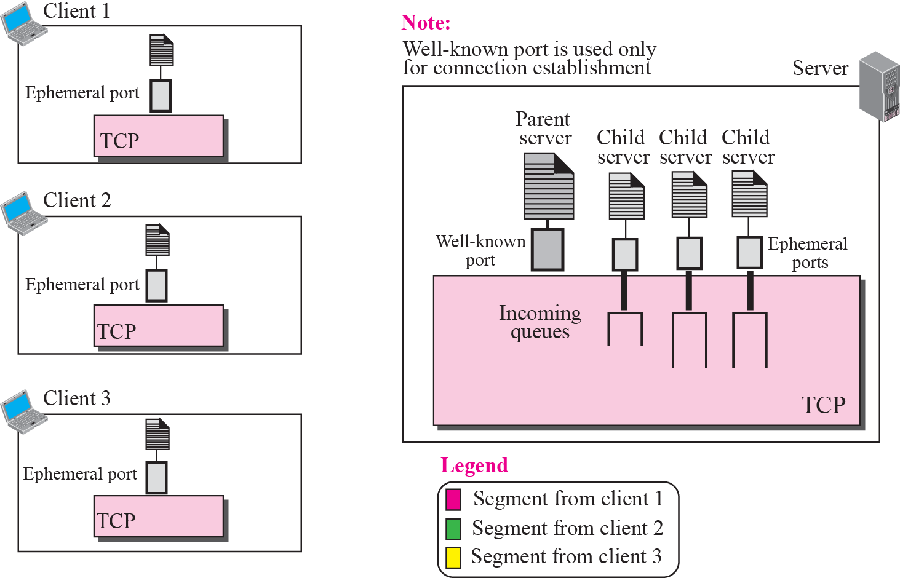
Figure 17.3 Connection-oriented concurrent server

Slide 8

Note
An interface is a set of instructions designed for interaction between two entities.

Slide 9
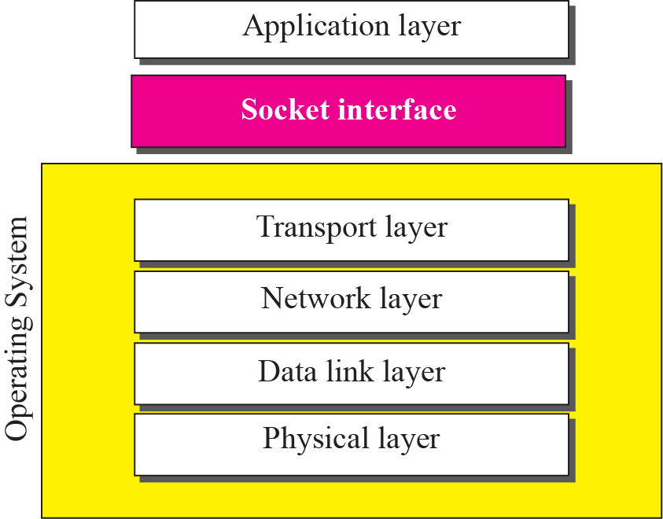
Figure 17.4 Relation between the operating system and the TCP/IP suite
Figure shows a conceptual relation between operating system and the TCP/IP protocol suite.
Socket interface, as a set of instructions, is located between the operating system and the application programs.
To access the services provided by the TCP/IP protocol suite, an application needs to use the instructions defined in the socket interface.

